Slide 1

Introducing Constructs
Dr Oliver Clark

Slide 2
This Video
The measurement of psychological attributes
Constructs
Rationalist and Relativist models

Slide 3
Constructs
Unobservable ‘latent’ variables
Inferred through observable behaviours
Generally we make assumptions about long run scores

Slide 4
Constructs
Frautraversion
Flake & Fried (2020) – Measurement Schmeasurement
Our measures must be up to scratch!

Slide 5
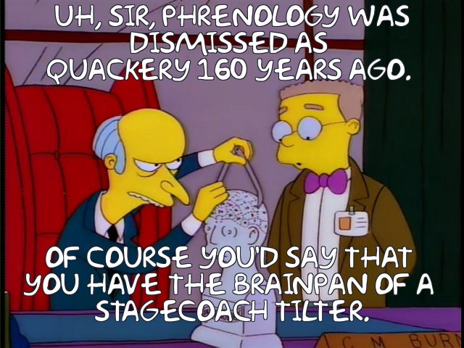
Constructs
Intelligence
Aggression
Ambivalent Sexism (Glick & Fiske, 2001)
Personality
Rape Myth Acceptance – Payne et al (1999)

Slide 6
Constructs
Hot sauce task – Lieberman et al (1999)
Aggression -> Hot Sauce
Hilgard (2020)

Slide 7
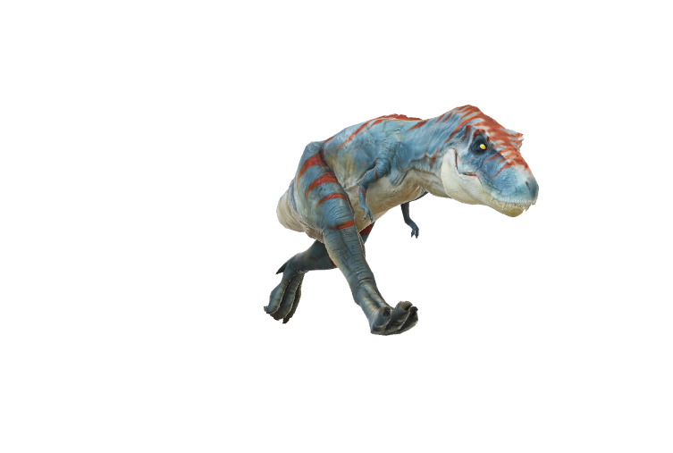
Constructs
Typical Behaviours
Intentions
Attitudes
Lexical Approach

Slide 8
Constructs
Tests
Inventories

Slide 9
Constructs
Realist Ontology
Borsboom (2005)

Slide 10
Constructs
Realist Ontology
Reflective Model of Measurement

Slide 11
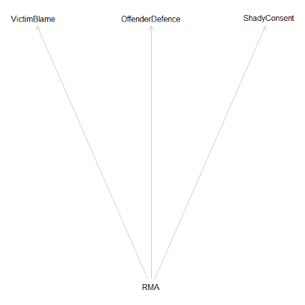
Constructs
Reflective Model of Measurement
Logical Fallacy – Affirming the Consequent

Slide 12
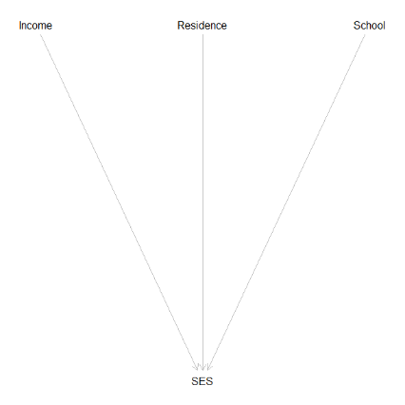
Constructs
Relativist or Constructionist Ontology
Formative Model

Slide 13
Constructs
Constructs
Relativism
Behaviours
Realism
Tests
Chapter 1: Boresboom (2005) Measuring the Mind

